Slide 1
Latin in the UK

Slide 2
UK education system
Age 3-5: Pre-school
Age 5-11: Primary school
Age 11-18: Secondary school
Age 18+: University

Slide 3
UK National Statistics
UK Population | 66,000,000
Year group size | 750,000
Secondary schools | 4,500
Students in a secondary school | 1,000
Students in a school year group | 150-200
Class sizes (Age 5-16) | 25-30
Class sizes (Age 16-18) | 1-20

Slide 4
UK Latin Statistics (2017)
Year group size | 750,000
Start Latin at age 11 (or up to 14) | 50,000 (6.5% of students)
Studying Latin at age 16 | 12,000 (1.6% of students)
Studying Latin at age 18 | 1,500 (0.2% of students)
First year Latin at university | 400 (<1% of starters)
Total studying Latin at any one time | 120,000 – 140,000 students

Slide 5
Typical school Latin department sizes
Age | School 1 | School 2
11-12 | 0 | 0
12-13 | 65 | 0
13-14 | 43 | 0
14-15 | 23 | 8
15-16 | 21 | 9
16-17 | 2 | 0
17-18 | 4 | 0

Slide 6
Rebuilding Latin in the UK 1999 – 2015 Working with teachers of other subjects

Slide 7
UK secondary schools offering Latin
 | 1999 | 2015
Total number of schools offering Latin | 650 | 1,125
State comprehensive schools | 100 | 558
State grammar schools | 110 | 118
Independent schools | 440 | 449

Slide 9
Latin clubs in 2 schools with no Latin teachers
After school (3:30 – 4:30 p.m.)
Once a week
Organised by a teacher who is not a specialist in Latin (teacher of French)
Lesson content provided by email, by a Latin teacher
Students send work to the Latin teacher by email
Latin teacher sends marked work back to students
Latin teacher and non-specialist teacher discuss progress by phone or email.

Slide 11
Results
In tests, students performed better than students in ‘normal’ classrooms
After-school ‘clubs’ not compulsory
Students ‘self-select’
Studying Latin because they want to
Worked well for the first two years of a Latin course (= first 80 hours)
In second year, expanded to 20 schools.
In third year onwards, we wrote to 4,000 secondary schools
Each year another 50 schools started Latin

Slide 12
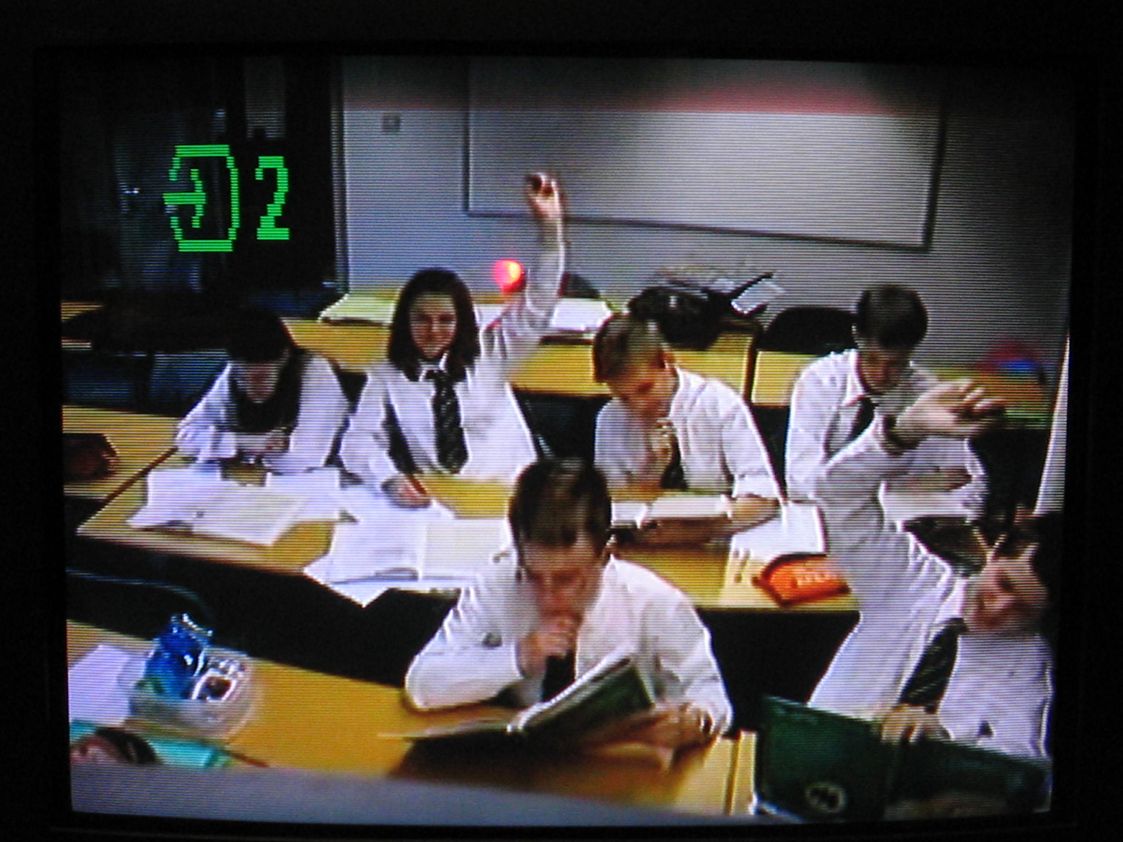

Slide 13
‘Non-specialist’ Latin teachers
80% studied some Latin at school
Most are modern language teachers
Skills in teaching languages
Interested in Latin
Attend Latin teachers’ training sessions
Gradually become ‘Latin teachers’ over time
Often comfortable to teach beginner classes, but initially lack confidence in teaching higher level classes

Slide 14
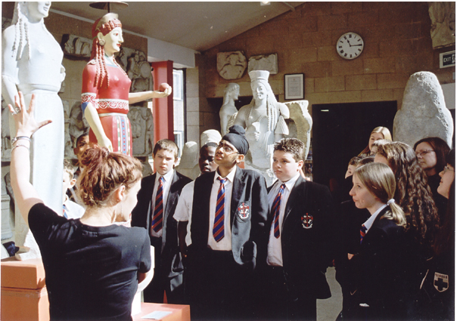

Slide 15
What support do non-specialist teachers need?
Latin teachers thought:
Training (26%)
Support from Latin specialist teachers (24%)
Resources (15%)
Non-specialists said:
Training (26%)
Support from Latin specialist teachers (14%)
Resources (44%)

Slide 16
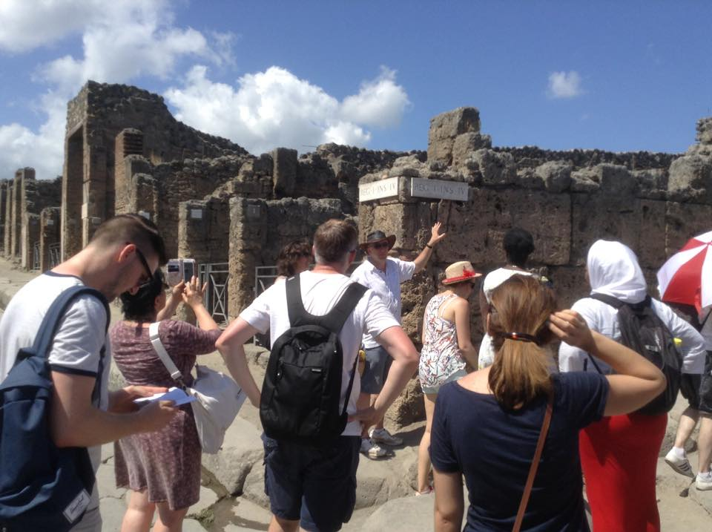

Slide 17
Resources
Story reading software
Auto-marking software
Vocabulary testers
Literature
Free commentaries linked to text
Free teacher notes
Free interlinear translations
Free study booklets

Slide 18
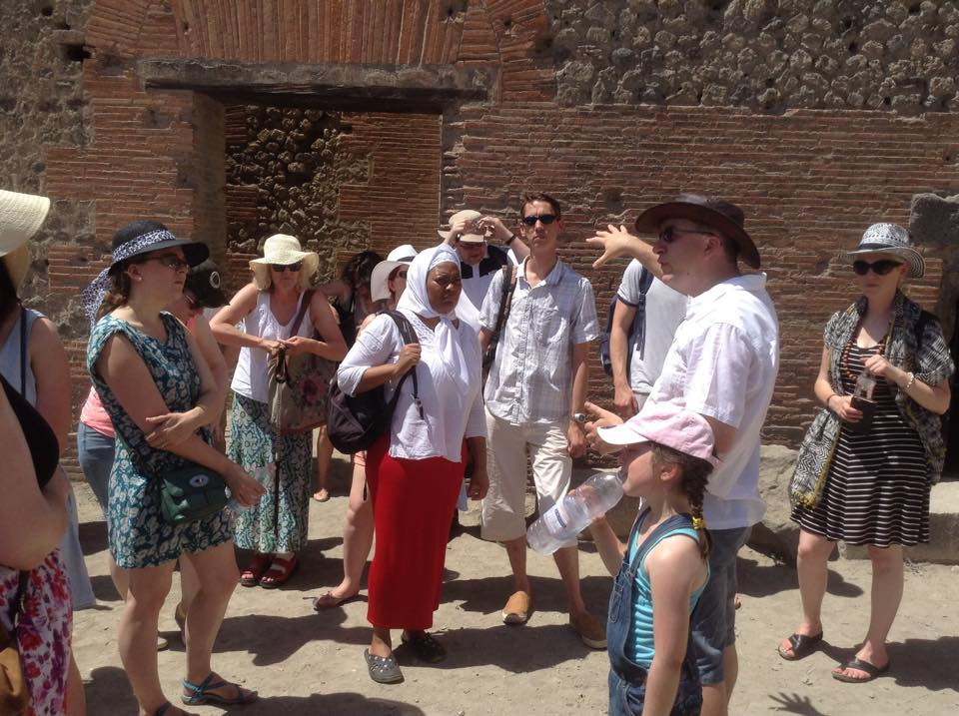

Slide 19
Overall conclusions
Start clubs in schools in no Latin teacher (most schools had some teachers who had studied Latin themselves at school)
Support by email, video-conference/Skype, older students helping in lessons
Continuation higher when schools pay than when it is free!
Some non-specialists gradually become specialists
Create resources for non-specialists
Develop training for non-specialists
Ensure Latin qualifications are similar in demand to other subjects

Slide 20
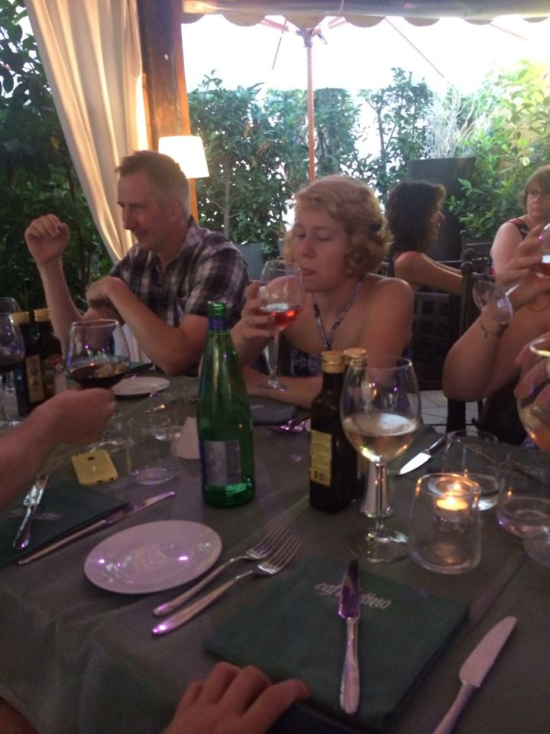

Slide 22
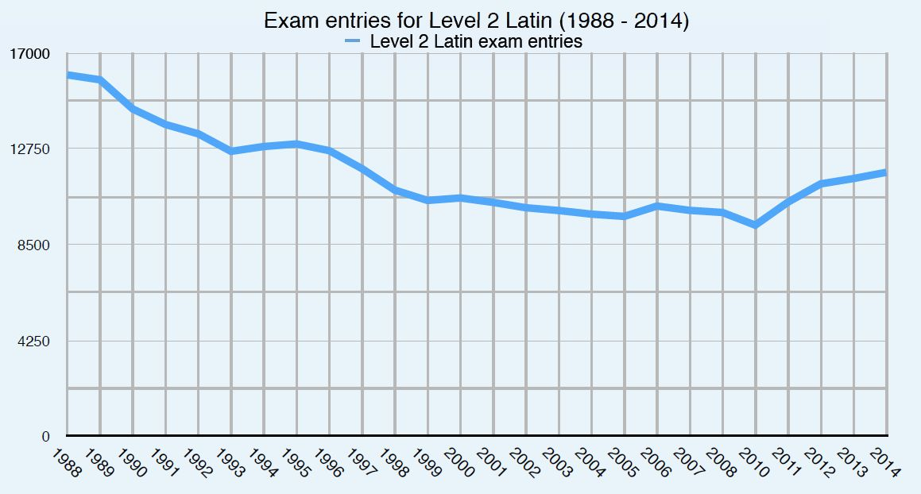
Students studying Latin at age 16 (1988 – 2014)

Slide 23
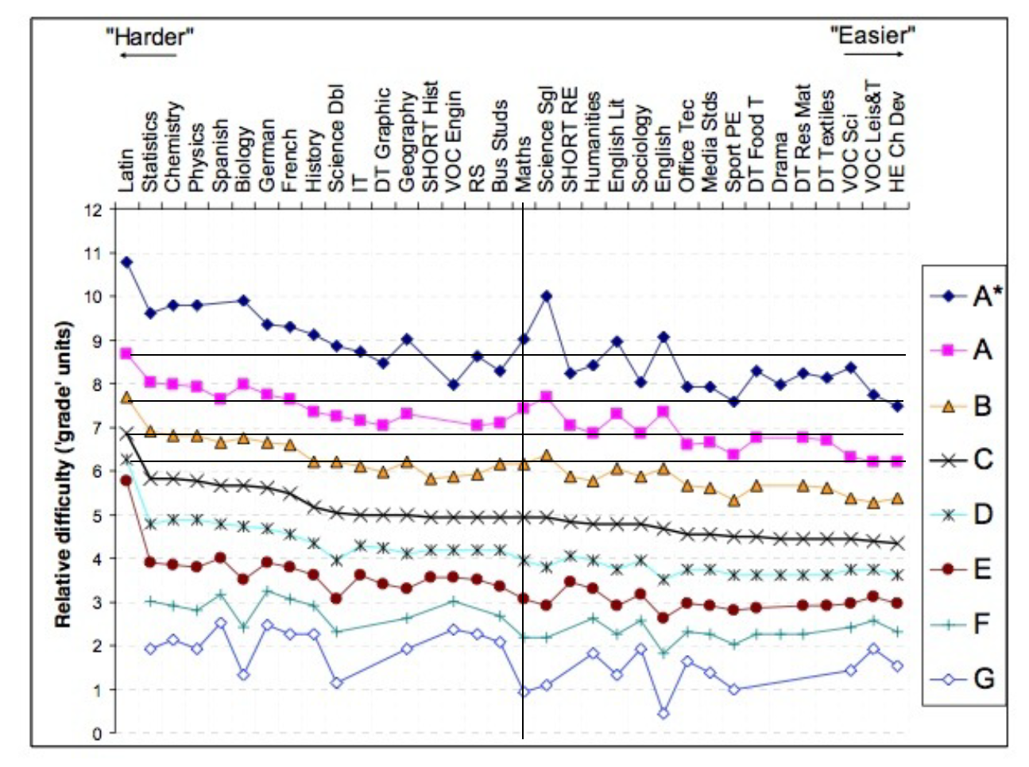

Slide 24
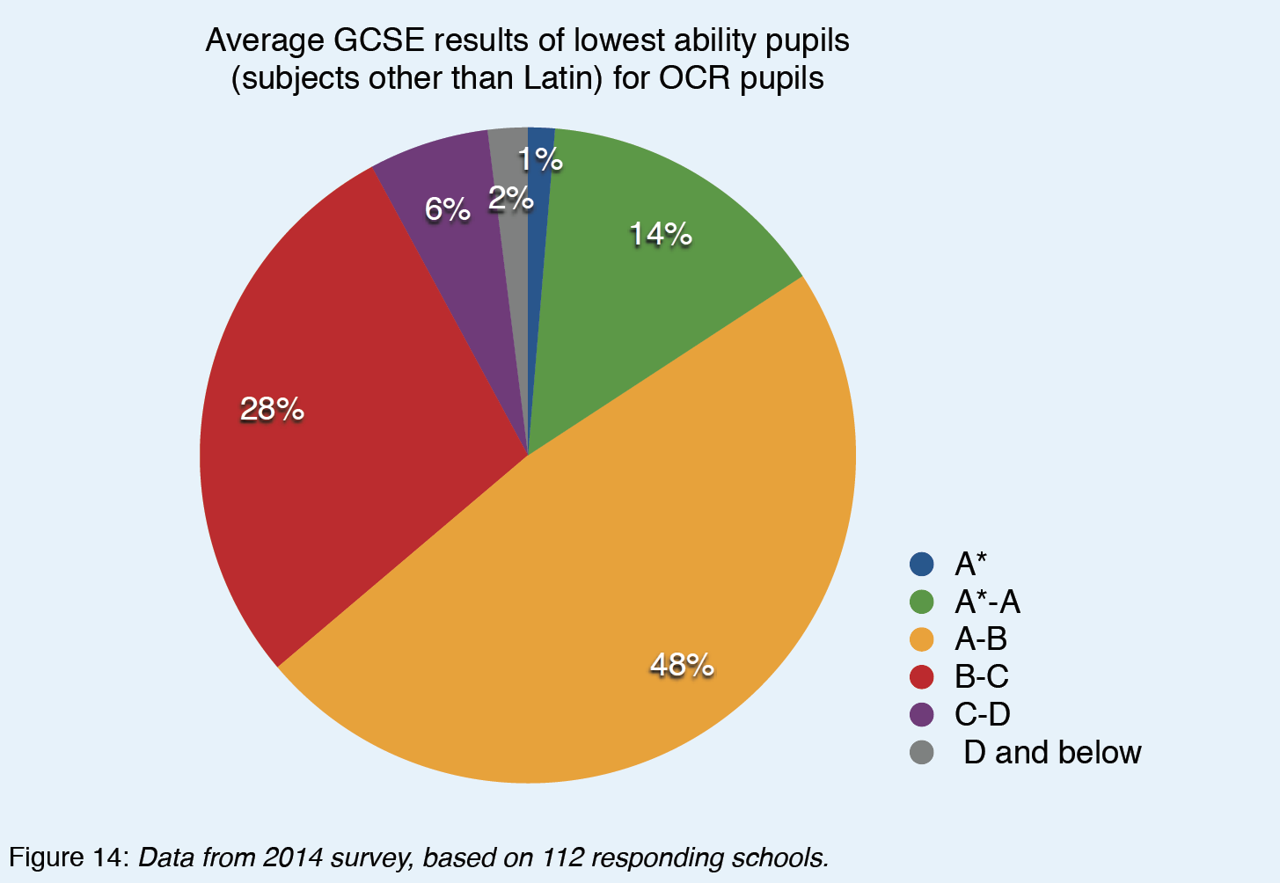

Slide 25
